Slide 1

OUTLAND ADVENTURES
Group 3: Bryce Kellas (Captain), Charlene Centeno, James Beck, Andrew McCloud

Slide 2
Case Study: OUTLAND ADVENTURES
Outland Adventures is a company that caters to people who enjoy camping and hiking in far off places. The goal of the company is to arrange guided trips and provide equipment when needed. With this company, they needed to optimize the organization. In order for this to happen, the owners needed to know if they have enough customers that buy equipment in order for them to keep equipment sales, if there are any locations that they conduct treks that have a declining trend in bookings and if any of their inventory is over 5 years old.

Slide 3


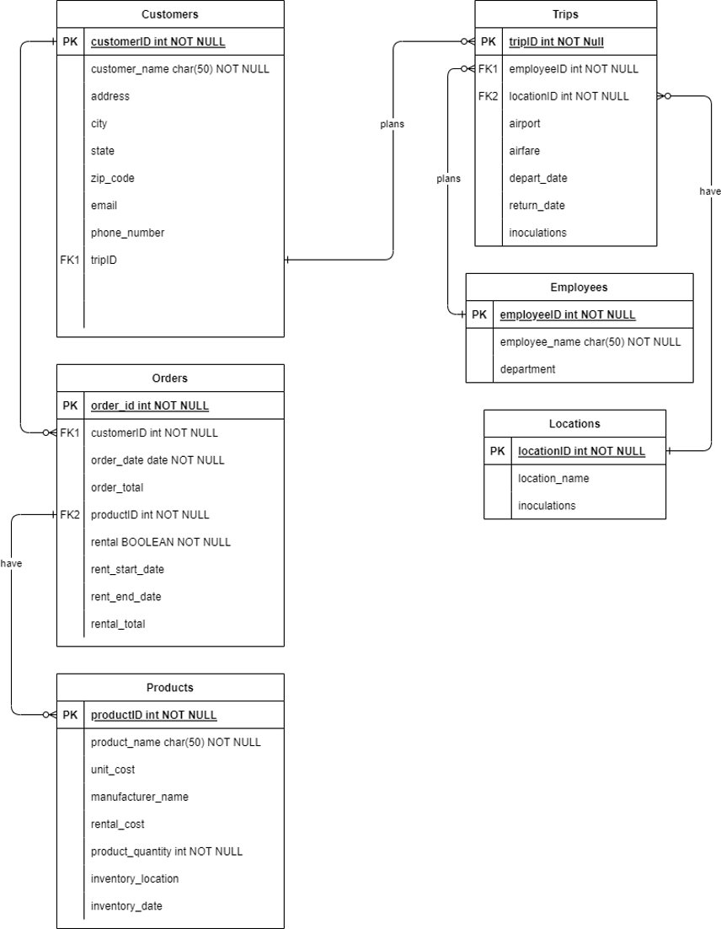

ERD

Slide 4
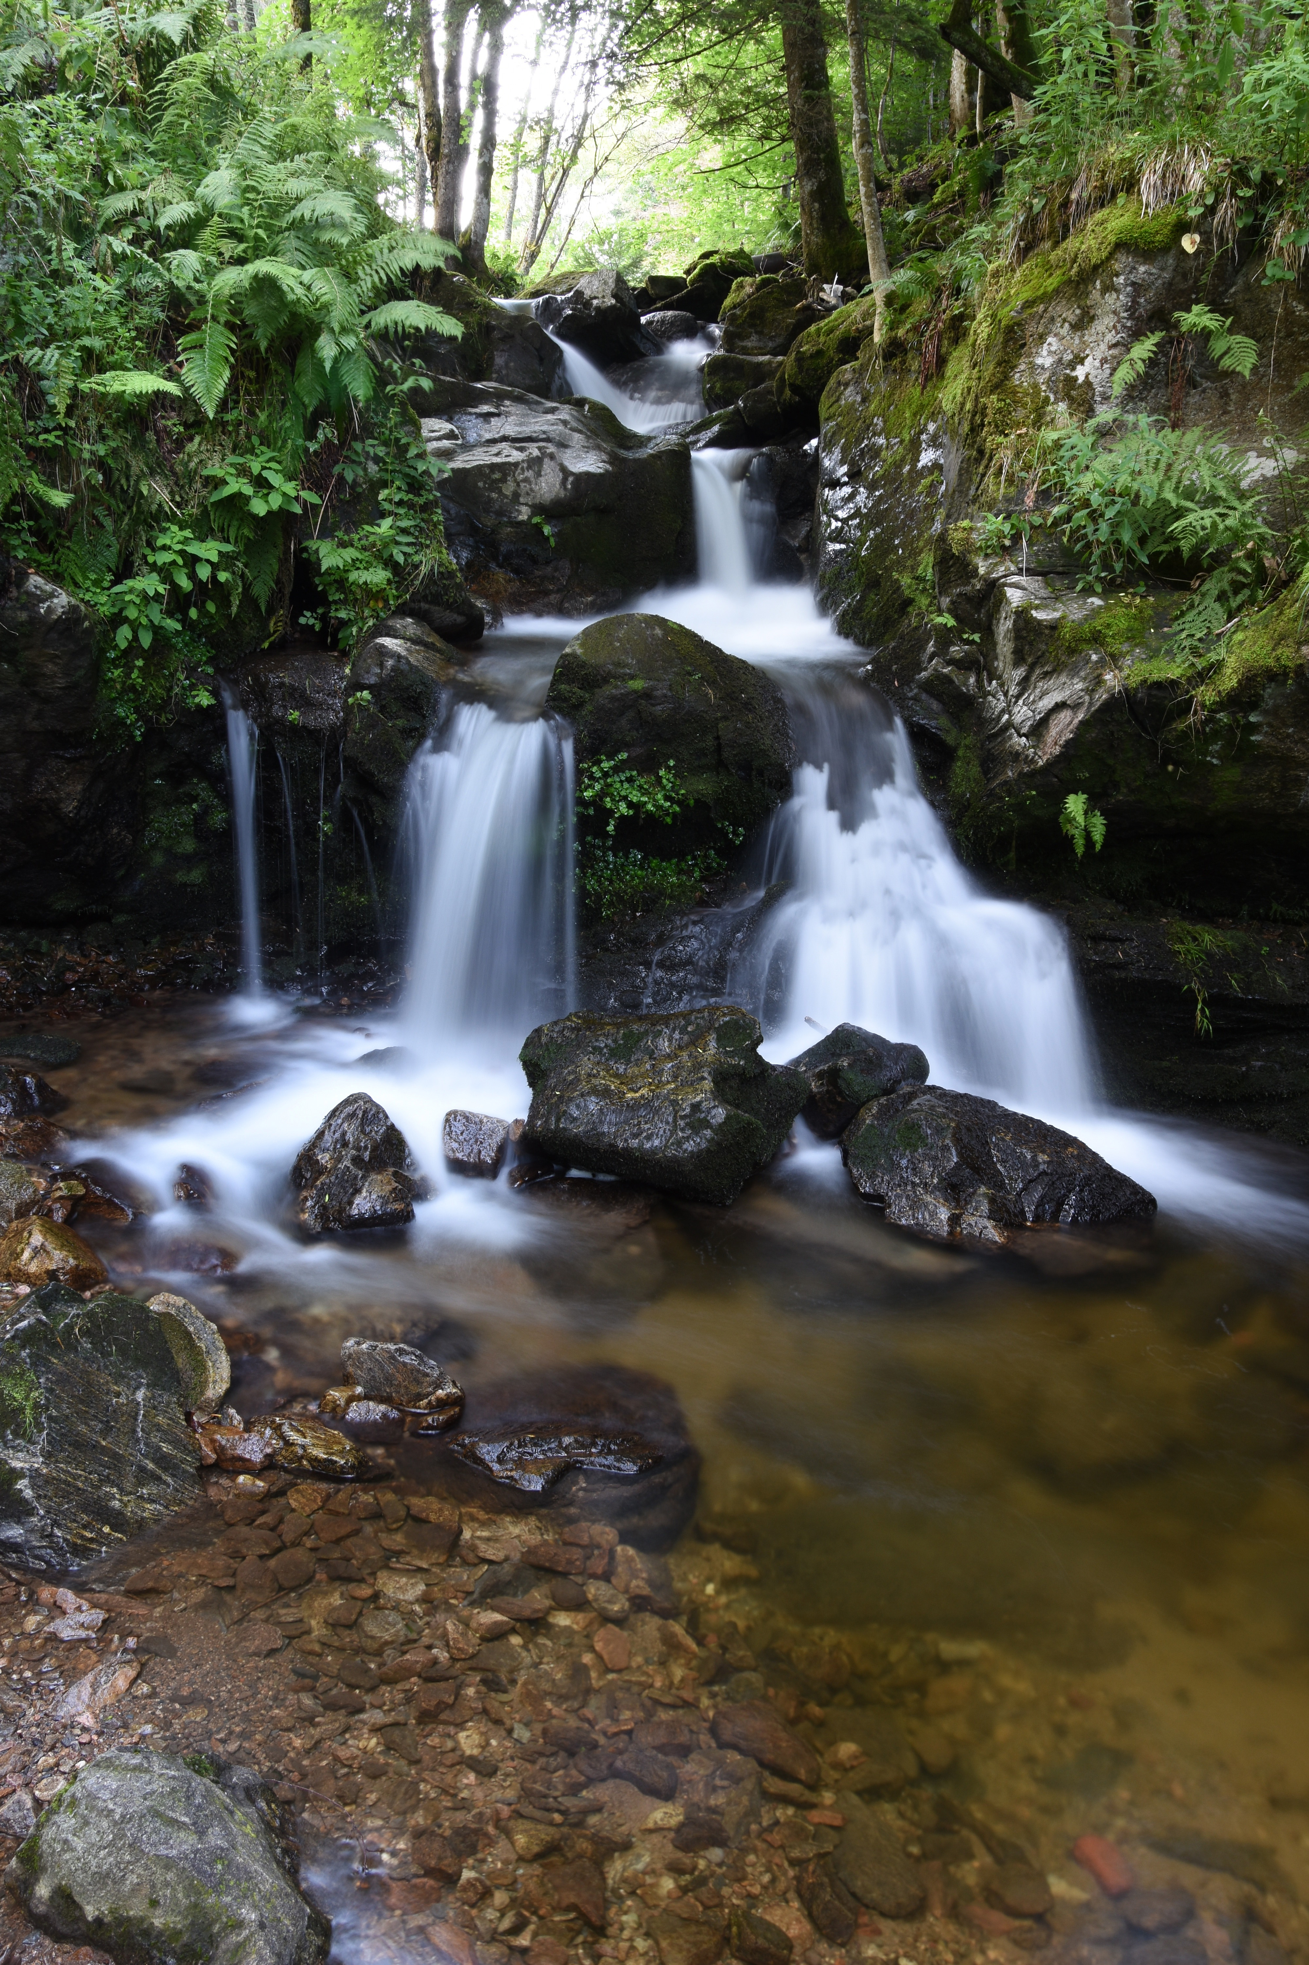
REPORTS
For this case study, we had to generate three reports.
check equipment sales
check treks that were conducted to see if any of them have a downward trend in booking
check the inventory to see if any of the equipment was more than 5 years old

Slide 5
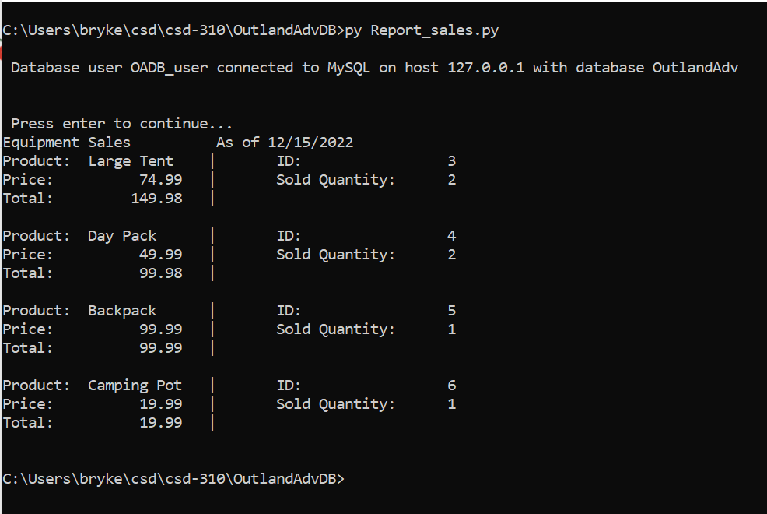
Report: EQUIPMENT SALES
Pulls each Product that has been ordered along with its ID, Price, Sold Quantity, and Total.
Used to determine the revenue from how many products have been ordered as of the date the report is published.

Slide 6
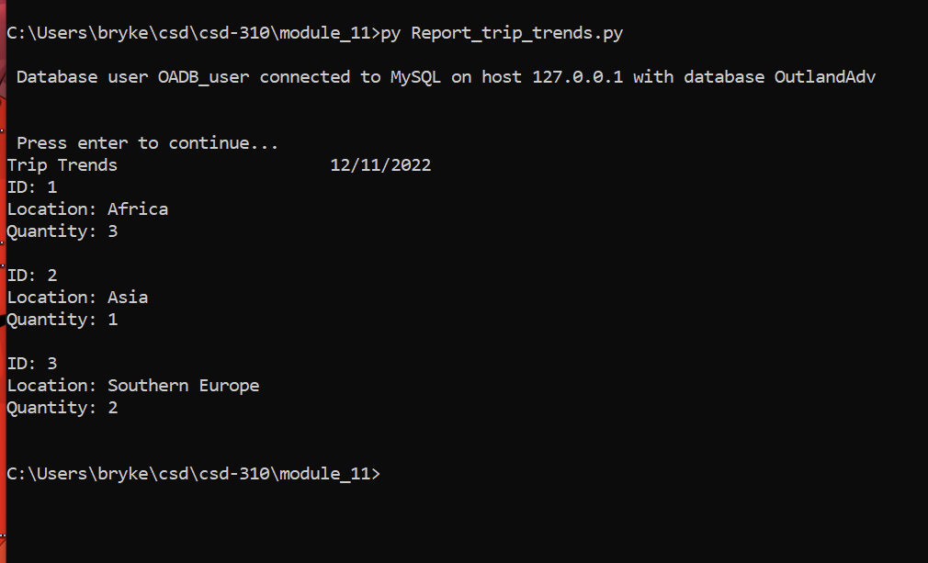
REPORT: TREK TRENDS
Displays each Location available along with Quantity of trips that have been made for each.
Determines booking trends among the available locations.

Slide 7
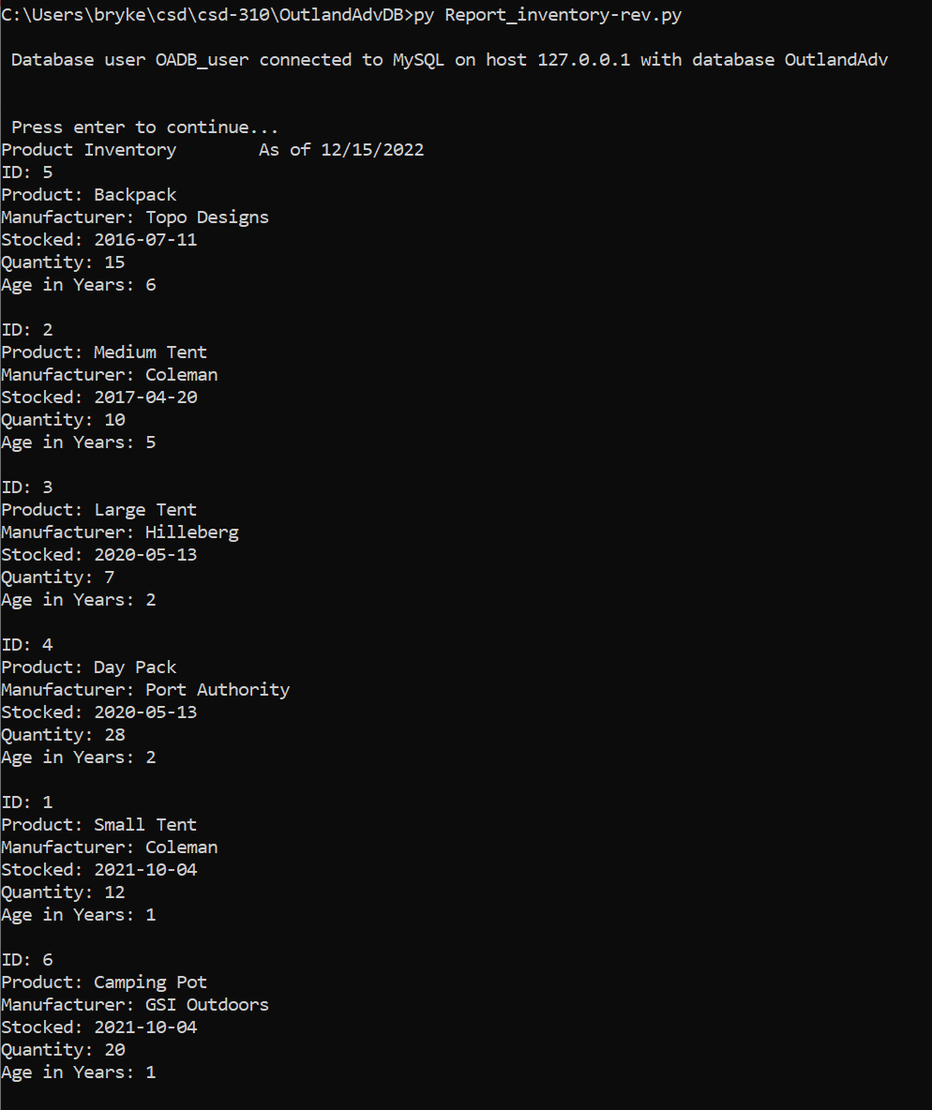
REPORT: INVENTORY AGE
Displays each Product, its ID, the Manufacturer, Stocked date and Age in Years.
The report is sorted from oldest to newest Products.
Stocked date is the date the product entered the inventory either as a new item or as a replenishment.
Age in Years is calculated number of years the product has been in inventory since its Stocked date

Slide 8

ASSUMPTIONS
We assumed that for the inventory age report, most items would have been bought in bulk and share the same inventory dates.
Inoculations and proof required from customers required by Outland Adventures.
Outland Adventures plans multiple trips for a customer, but each trip is planned for a single location.

